Slide 1
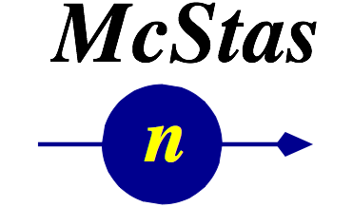





Slide 2
Agenda
General concepts
Most important samples:
(Incoherent scatterer)
Powder and Single Crystal
SANS
Isotropic_sqw

Slide 3
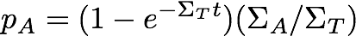
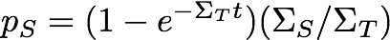
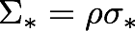
Samples
For a non-thin sample the probabilities for absorption, transmission or scattering are given by
t = sample thickness
macroscopic cross section [cm⁻¹]
microscopic cross section [barn/atom]
1 barn = 10⁻²⁴cm²
number density [atoms/cm³]

Slide 4
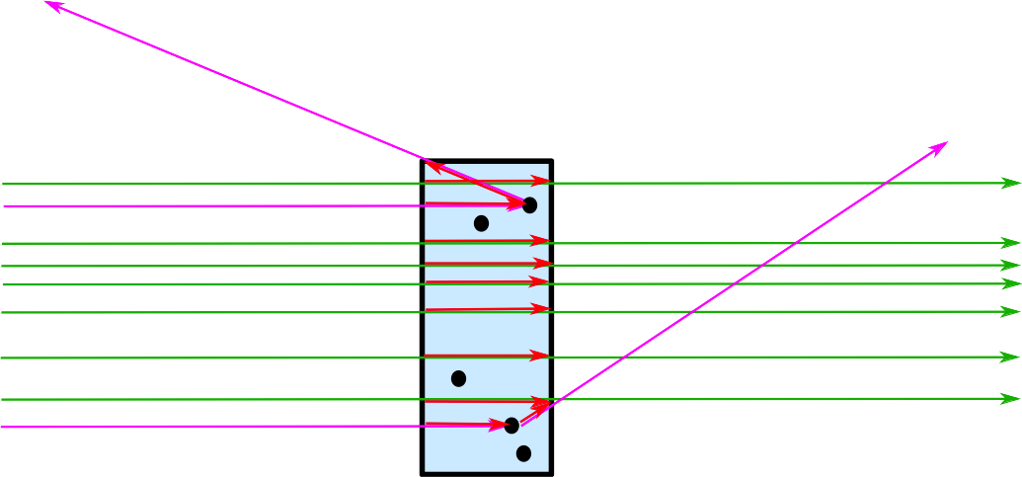
Samples in General in McStas
A neutron ray hitting a sample can be:
transmitted+absorption, or scattered+absorption

Slide 5
Sample shapes
Simple geometrical shapes

Slide 6
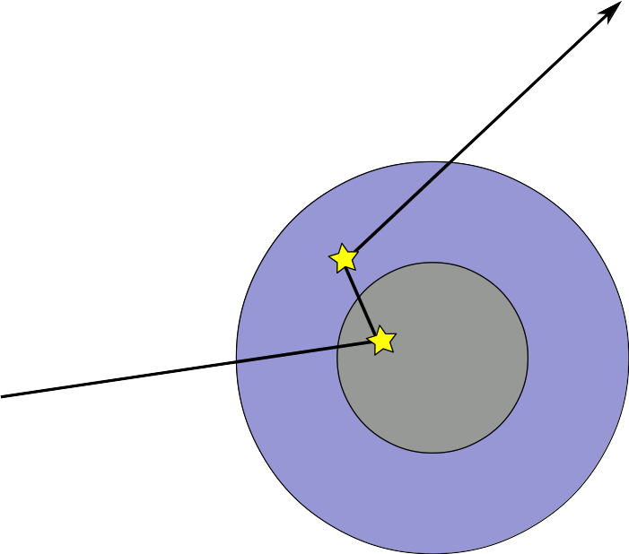
Sample shapes
For isotropic materials these can be ”concentric”, i.e. something can be put ”inside”

Slide 7
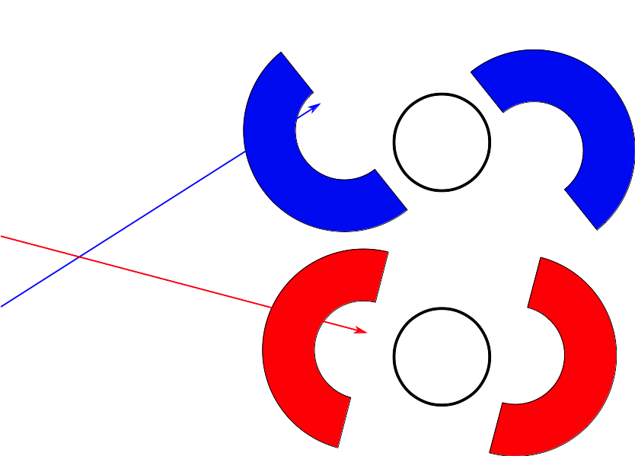
Sample shapes
For isotropic materials these can be ”concentric”, i.e. something can be put ”inside”

Slide 8
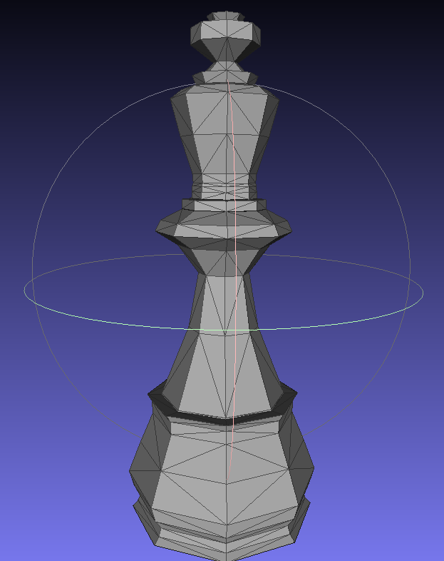
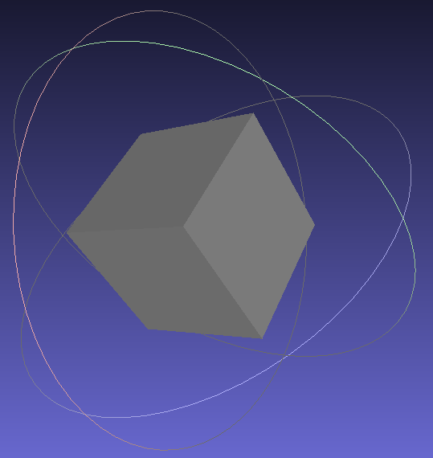
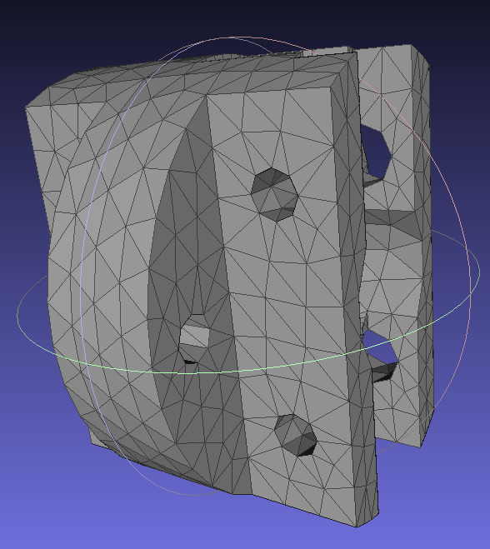
Isotropic material samples can use OFF/PLY for ”any” geometry
An additional complex geometry enables to use any point set to describe the material volume (geomview OFF file).

Slide 9
Isotropic material samples can use OFF/PLY for ”any” geometry
An additional complex geometry enables to use any point set to describe the material volume (geomview OFF file).
These can then NOT be concentric

Slide 10
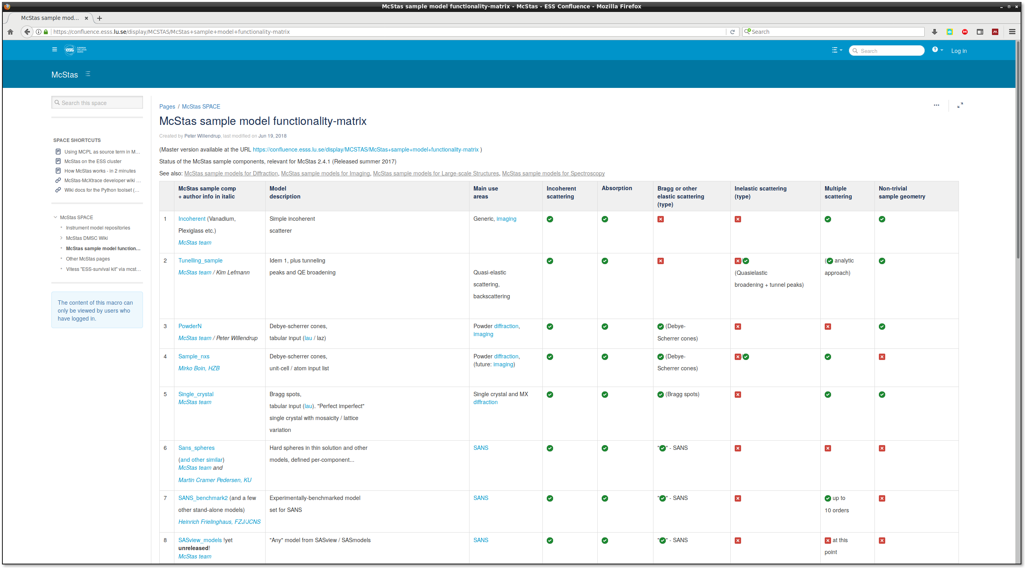
McStas sample overview table

Slide 11
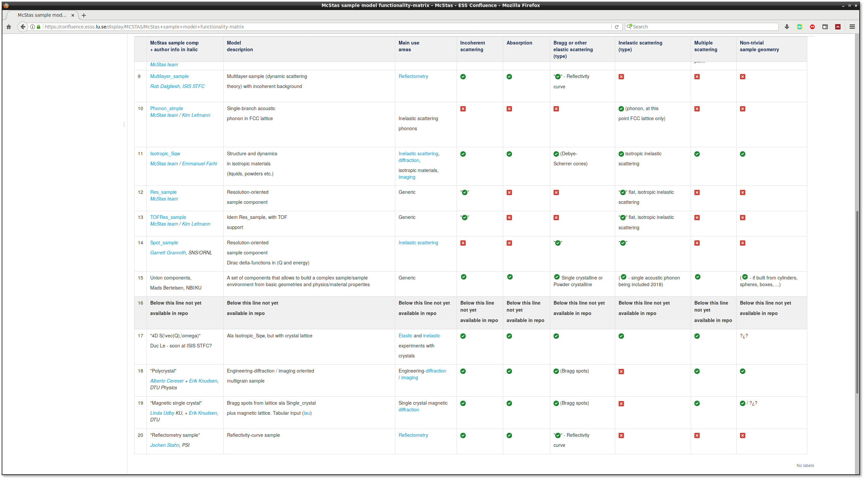
McStas sample table overview
But since it is impossible to read this table – here’s where it’s at:
https://confluence.esss.lu.se/display/MCSTAS/McStas+sample+model+functionality-matrix
… or take a look in the Dropbox for at PDF-version.

Slide 12
Samples – elastic, structure
( Incoherent.comp: Incoherent scattering (and absorption) )
PowderN.comp : Elastic Bragg scattering from an ideal powder
Single_crystal.comp : Bragg scattering from single crystals
Small Angle Scattering

Slide 13
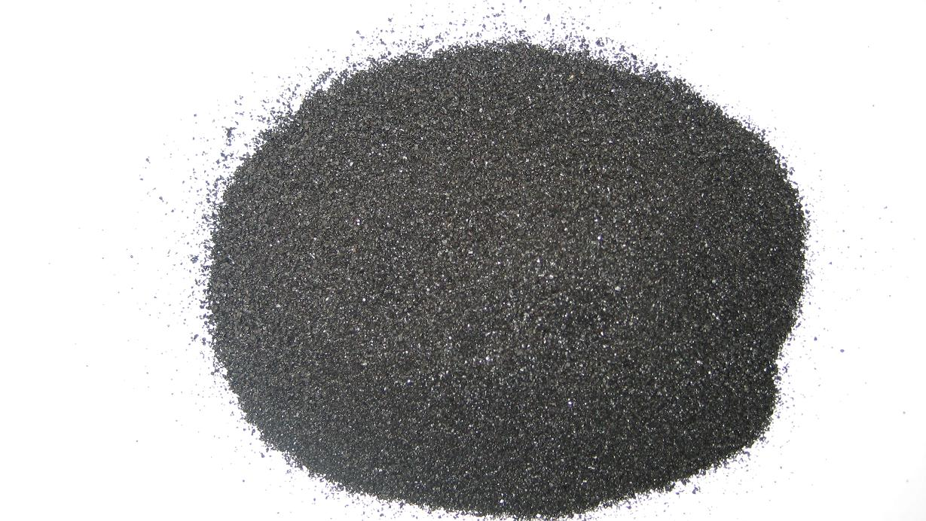
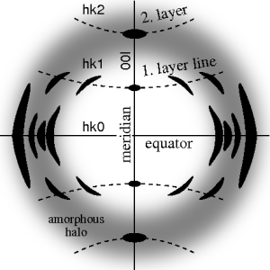
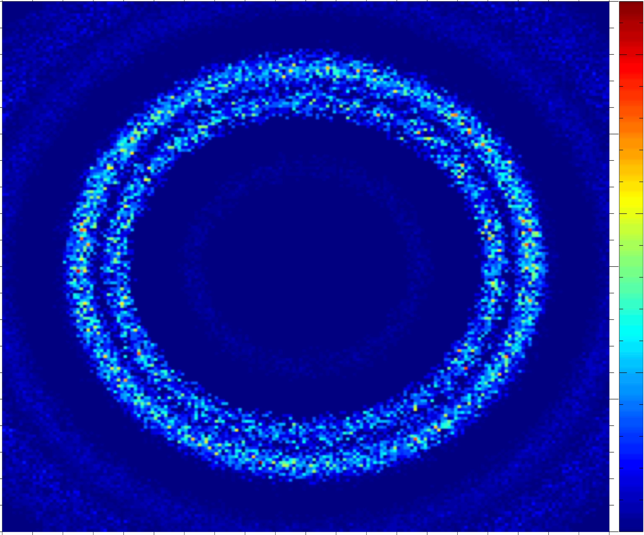

From single crystal / crystallites to powder….
Single crystal
Polycrystal with a little disorder, i.e. a preferred orientation, texture
Powder with complete disorder

Slide 14
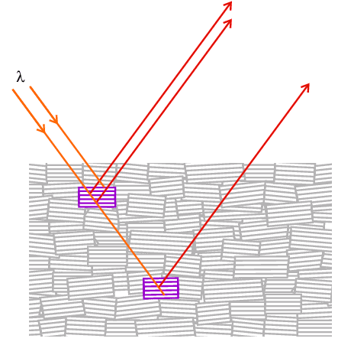
Single Crystal model
Models ideally imperfect crystal:
Peak broadening is dominated by mosaic => not appropriate for highly perfect crystals.
“Space group symmetries” considered out of scope.
Optimized for small unit cells but…
No assumption about unit cell, orientation etc.
Gaussian model for mosaic (see later)
Courtesy University College London

Slide 15
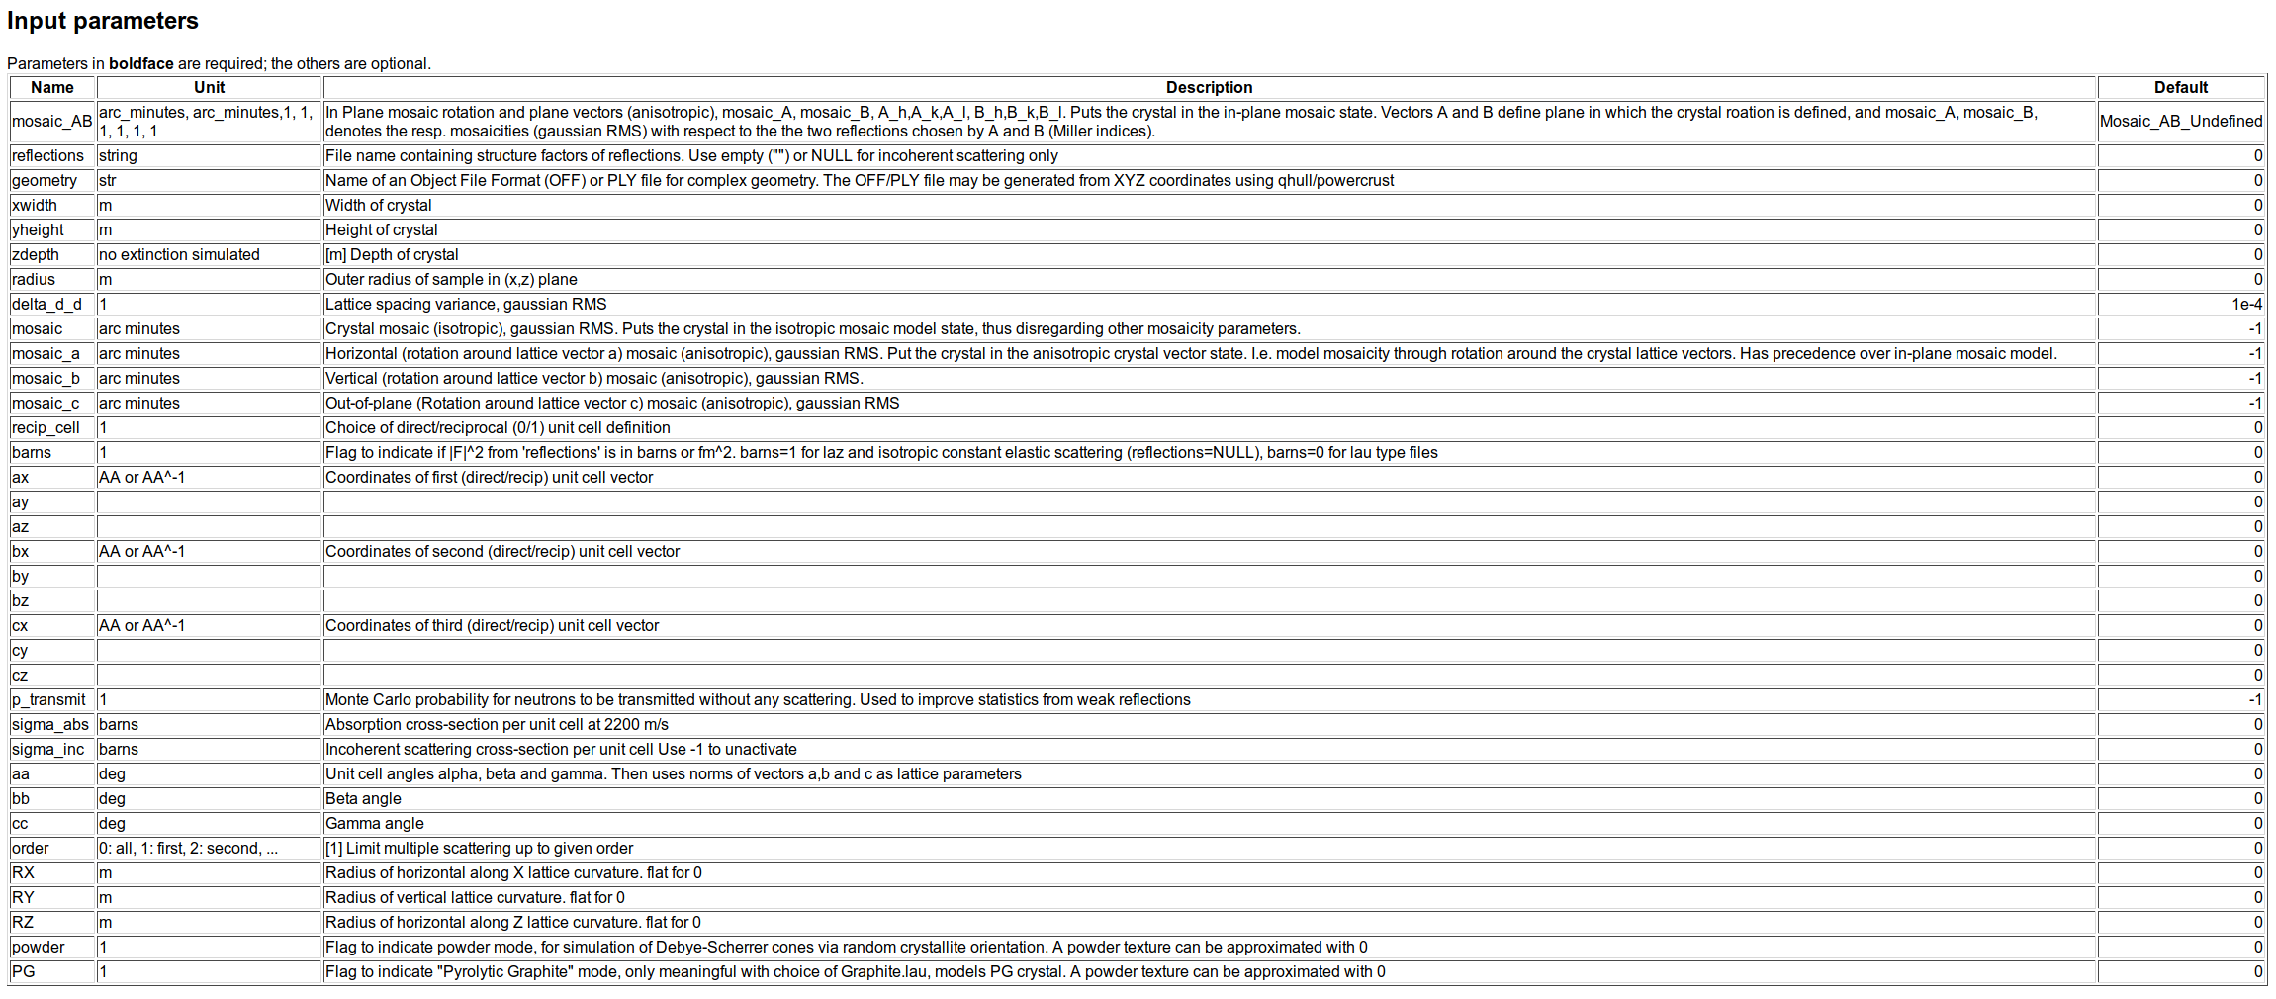
Single Crystal

Slide 16
Single Crystal
Unit cell vectors (ax,ay,az, bx, by,bz, cx,cy, cz). Encodes the crystal orientation relative to the Component’s orientation

Slide 17
Single Crystal
Mosaicity parameters: mosaic, mosaic_a, mosaic_b, mosaic_c, mosaic_AB

Slide 18
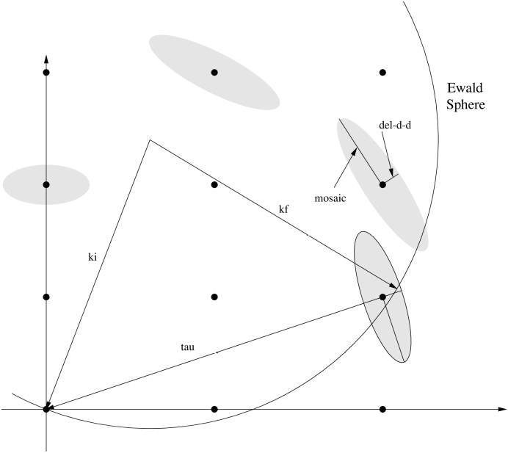
Single Crystal mosaicity

Slide 19
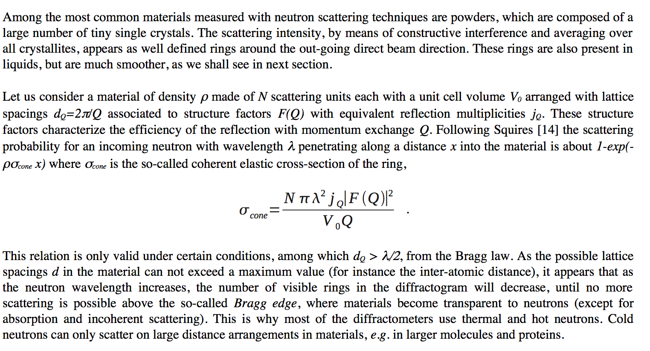
9.2 PowderN

Slide 20
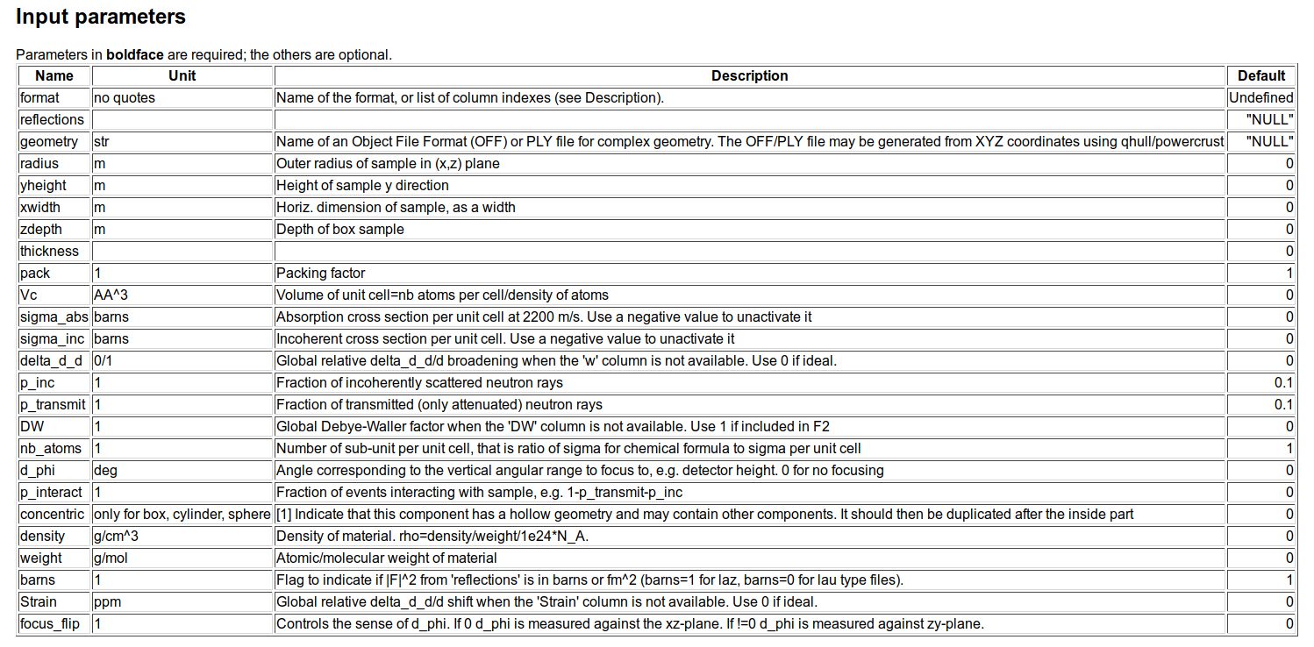
PowderN inputs

Slide 21
PowderN inputs
Sampling parameters
Concentric = Hollow Powder [cylinder]

Slide 22
PowderN inputs
Only scatter into a part of 4π

Slide 23
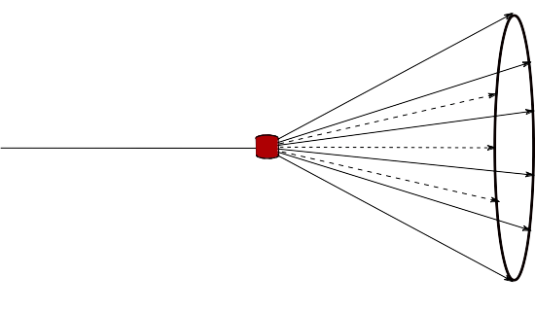
PowderN inputs
Only scatter into a part of 4π

Slide 24
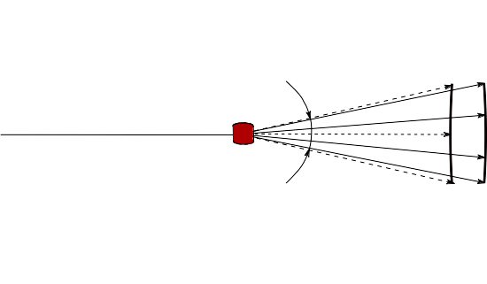
PowderN inputs
d_phi
Only scatter into a part of 4π

Slide 25
Reflection files for Single_crystal and PowderN
# TITLE *Aluminum-Al-[FM3-M] Miller, H.P.jr.;DuMond, J.W.M.[1942] at 298 K
# CELL 4.049320 4.049320 4.049320 90.000000 90.000000 90.000000
# SPCGRP F M 3 M CUBIC STRUCTURE
# ATOM AL 1 0.000000 0.000000 0.000000
# SCATTERING FACTOR COEFFICIENTS: AL F= 0.345 CM-12
# Reference: Physical Review (1940) 57, 198-206
#
# Physical parameters:
# sigma_coh 1.495 coherent scattering cross section (single atom) in [barn]
# sigma_inc 0.0082 incoherent scattering cross section (single atom)in [barn]
# sigma_abs 0.231 absorption scattering cross section (single atom) in [barn]
# density 2.70 in [g/cm^3]
# weight 26.98 in [g/mol] (single atom)
# multiplicity 4 in [atoms/unit cell]
# Vc 66.4 volume of unit cell in [A^3]
# v_sound 5100 in [m/s]
# v_sound_l 6420 velocity of longitudinal sound in [m/s]
# v_sound_t 3040 velocity of transversal sound in [m/s]
# T_m 933.5 melting temperature in [K]
# T_b 2792.2 boiling temperature in [K]
# At_number 13 atomic number Z
# lattice_a 4.04932 lattice parameter a in [Angs]
#
# Format parameters: Crystallographica format
# column_j 4 multiplicity 'j'
# column_d 5 d-spacing 'd' in [Angs]
# column_F2 7 norm of scattering factor |F|^2 in [fm^2]
# column_h 1
# column_k 2
# column_l 3
#
# h k l Mult. d-space 2Theta F-squared
-1 -1 -1 8 2.338 24.6973 21.3
-1 -1 1 8 2.338 24.6973 21.3
…
Lau datafiles
header
+
reflection list
Can be used with Single_crystal, PowderN, Isotropic_Sqw

Slide 26
Input for the PowderN
# TITLE *Corundum-Al2O3-[R3-CH] Graafsma, H.;Souhassou, M.;Harkem[1998] [corundum saphire:blue, ruby:red]
# CELL 4.757000 4.757000 12.987700 90.000000 90.000000 120.000000
# SPCGRP R -3 C TRIGONAL STRUCTURE
# ATOM AL 1 0.000000 0.000000 0.352110
# ATOM O 1 0.306260 0.306260 0.250000
# SCATTERING FACTOR COEFFICIENTS: AL F= 0.345 CM-12 ; O F= 0.581 CM-12
# Reference: Acta Crystallographica B (1998) 54, 193-195
#
# Physical parameters:
# sigma_coh 15.683 coherent scattering cross section for Al2O3 in [barn]
# sigma_inc 0.0188 incoherent scattering cross section for Al2O3 in [barn]
# sigma_abs 0.4625 absorption scattering cross section for Al2O3 in [barn]
# density 4.05 in [g/cm^3]
# weight 101.96 in [g/mol] for Al2O3
# multiplicity 6 in [Al2O3/unit cell]
# Vc 254.52 volume of unit cell in [A^3]
# T_m 2273 melting temperature in [K]
# T_b 3773 boiling temperature in [K]
# lattice_a 4.757 lattice parameter a in [Angs]
# lattice_c 12.9877 lattice parameter c in [Angs]
# lattice_cc 120 lattice angle gamma in [deg]
#
# Format parameters: Lazy format <http://icsd.ill.fr>
# column_j 17 multiplicity 'j'
# column_d 6 d-spacing 'd' in [Angs]
# column_F 13 norm of scattering factor |F| in [barn]
# column_h 1
# column_k 2
# column_l 3
#
# H K L THETA 2THETA D VALUE 1/D**2 SIN2*1000 H K L INTENSITY /F(HKL)/ A(HKL) B(HKL) PHA.ANG. MULT LPG
1 0 1 6.35 12.71 4.5175 0.0490 12.25 1 0 1 367.0 4.1 -4.08 0.00 180.00 6 82.14
0 0 3 7.10 14.20 4.0467 0.0611 15.27 0 0 3 110.0 4.3 4.32 0.00 0.00 2 66.01
0 1 2 7.57 15.13 3.7972 0.0694 17.34 0 1 2 10.9 0.8 0.84 0.00 0.00 6 58.18
…
Laz + Lau datafiles
header
+
reflection list
Can be used with PowderN, Isotropic_Sqw

Slide 27
Where to get these files…
$MCSTAS/data
Windows: c:\mcstas-2.2a\lib\data
Linux: /usr/(local)/share/mcstas/2.2a/data
OS X: /Applications/McStas-2.2a/Contents/Resources/mcstas/2.2a/data
- Or make your own via
Finding a CIF file for the given structure
e.g. from ICSD http://icsd.fiz-karlsruhe.de
Build one using VESTA
Process it using
cif2hkl tool that comes preinstalled with McStas
Crystallographica, using the guide
https://github.com/McStasMcXtrace/McCode/wiki/Single-crystal---and-generating-its-input

Slide 28
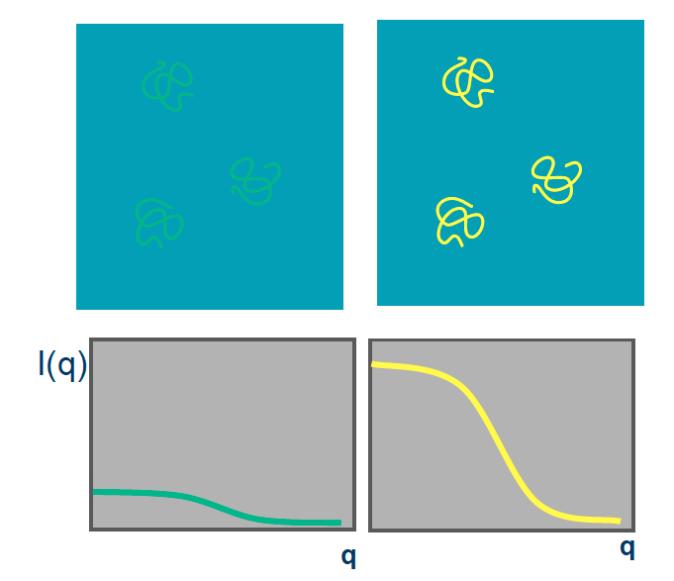
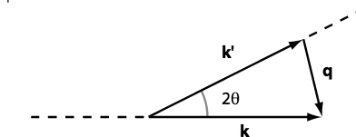
Small angle scattering SANS
SANS method can be used for many samples
Specific sample: Molecule + Liquid (buffer solution)
Isotropic scattering

Slide 29
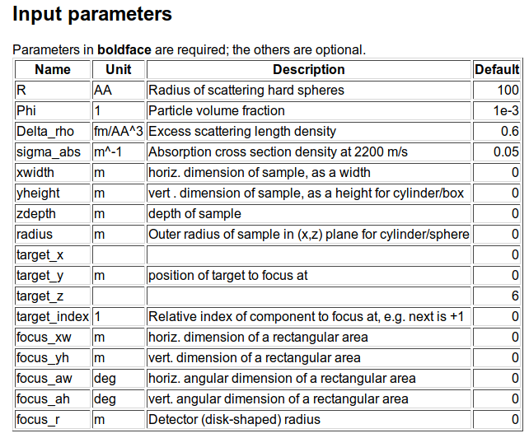
SANS spheres
Dilute, monodisperse, hard spheres in solution, with given contrast and radius

Slide 30
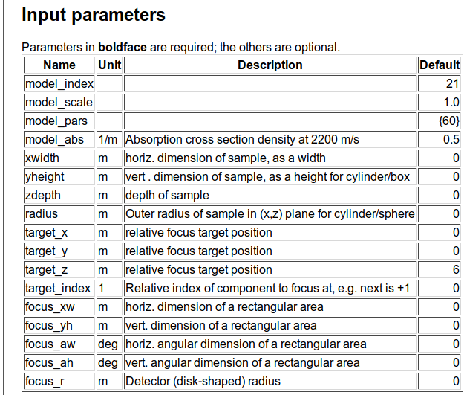
SasView_models

Slide 31
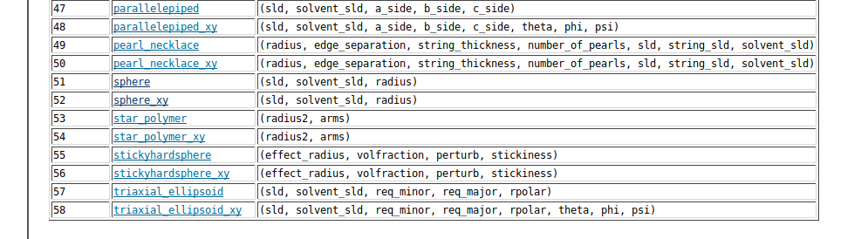
SasView_models

Slide 32
SANS other samples
McStas has a suite of SANS-models:
Try ellipsoidal and
cylindrical particles
-or-
Elliptic cylinders
Go for Nanodiscs and Liposomes
SANS_AnySamp.comp
SANS_DebyeS.comp
SANSCylinders.comp
SANSEllipticCylinders.comp
SANSGuinier.comp
SANSLiposomes.comp
SANSNanodiscs.comp
SANSNanodiscsFast.comp
SANSNanodiscsWithTags.
SANSNanodiscsWithTagsFast
SANSPDB.comp
SANSPDBFAST.comp
SANSShells.comp
SANSSpheres.comp

Slide 33
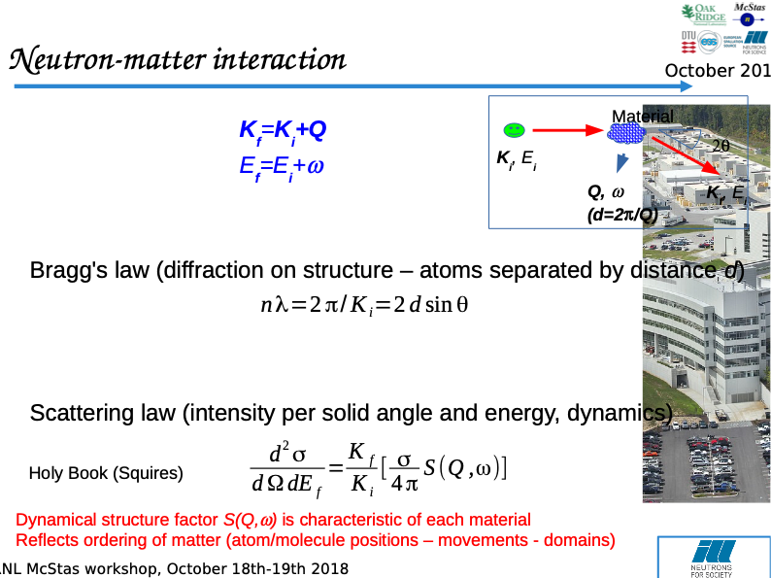

Slide 34
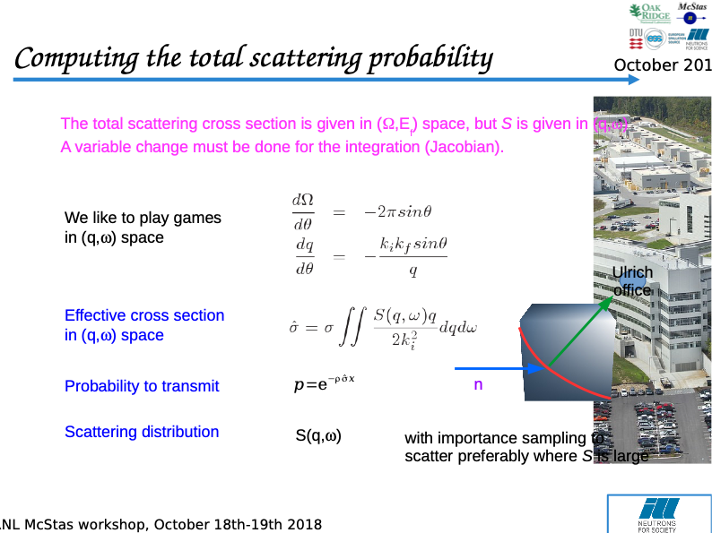

Slide 35
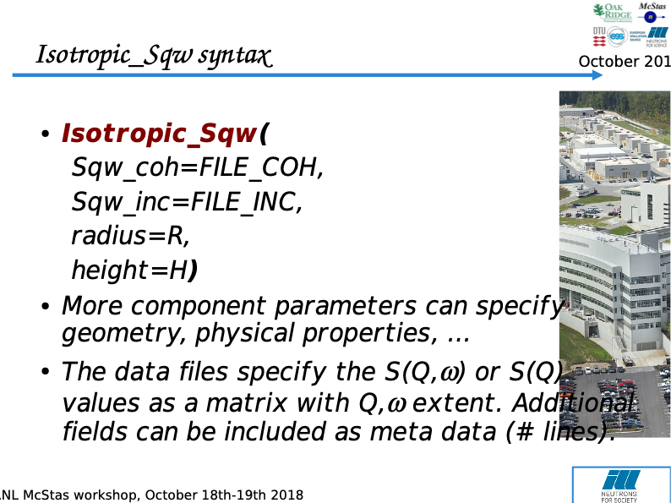

Slide 36
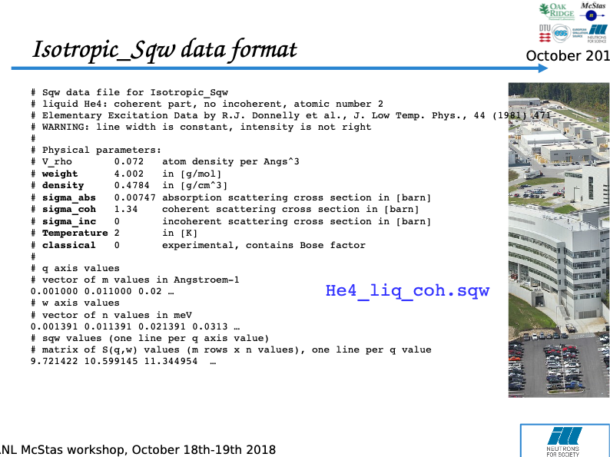

Slide 37
